Slide 1
PTC KAMAZ
KAMAZ
STRONG AND RELIABLE PARTNER
I квартал / 2016 год

Slide 2
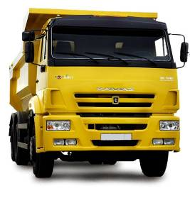
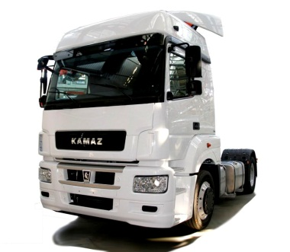
No. 1 TRUCK MANUFACTURER COMPANY
Wide model range:
More than 40 models and
1500 configurations
Production capacity:
60 thousands trucks per year
Russian market share 2015 – 57%
Sales and service network across Russia:
210 dealers
13 time Dakar rally champion
14 times recognized as “Best Russian exporter”
15th place in world rating of heavy trucks manufacturers
Notes:
2

Slide 3
SALES DYNAMICS FOR KAMAZ GROSS VEHICLE WEIGHT 8-40 TONNS
Notes:
3

Slide 4
MARKET SHARE OF PRODUCERS ON RUSSIAN MARKET (14-40T) 2015
Actual truck market share for product segment in Russia (14-40 T)
2015
Technological tractor truck (65116, 44108) | 51%
Long haul tractor truck (5460, 6460) | 28%
High sided non-AWD (65117, 43253) | 66%
High sided AWD (43114, 43118) | 41%
Dump trucks | 81%
Chassis + special vehicles including AWD (lean-to) | 74% 67%
Notes:
4

Slide 5
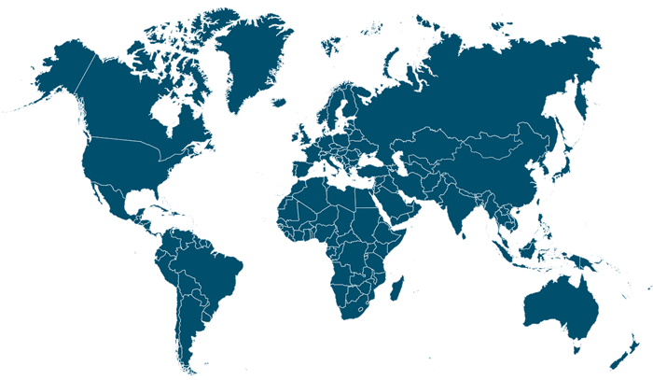
OJSC «KAMAZ» ASSEMBLY PLANTS
Assembly plants: Kazakhstan, India, Vietnam, Lithuania, Azerbaydzhan, Venezuela
Notes:
5

Slide 6
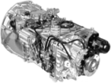
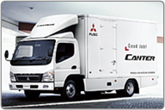
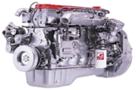
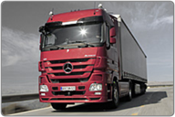
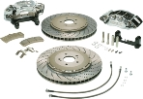
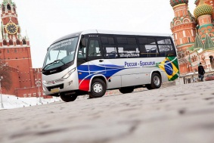
STRATEGIC PARTNERSHIP
Product portfolio expansion
Parts base development
ZF Gear boxes
JV «ZF КАМА»
Cummins Engines
JV «CUMMINS КАМА»
Braking gear, torsion vibration damper
JV «KNORR-BREMSE КАМА»
Cylinder-piston group
JV «FEDERAL MOGUL
NABEREZHNYE CHELNY»
Medium duty trucks
JV with Mitsubishi FUSO
Heavy duty trucks
JV with Daimler
Buses
LLC «KAMAZ-Marko»
High level of localization
Notes:
6

Slide 7
KAMAZ. COMPREHENSIVE APPROACH AT GLOBAL MARKET.
EVERYTHING FOR THE CUSTOMER
Trucks, trailers, buses, engines, spare parts
Wide model range:
improved technical characteristics
broad range of configurations
reasonable price
Own special vehicles plants
And established contacts with 250 special vehicles plants
Sales and service network
210 dealers in Russia
24 dealers in non-CIS countries
54 dealers in CIS
Leasing company:
110 dealers – representatives of «LC «KAMAZ» in regions
Trade-in in Russia:
carrying out of overhaul maintenance
Recycling
Marketing
Competence in promotion, established contacts with governments institutions, corporate clients, established client base

Slide 8
PRODUCT DEVELOPMENT
KAMAZ new generation trucks
KAMAZ with improved consumer performance
KAMAZ previous generation trucks
Comfortable cabin with 2 sleeping berths;
Fuel consumption reduced by 10%;
Period between service maintenance increased by 50%;
Dead weight efficiency increased by 10%;
Advanced electronic systems;
Efficiency growth by 30%
Improved comfort and ergonomics
Fuel consumption reduced by 10%
Service maintenance recurrence 50 000 km
Payback period reduced by 10%
Million km
Thousand km
Thousand km
Truck life span

Slide 9
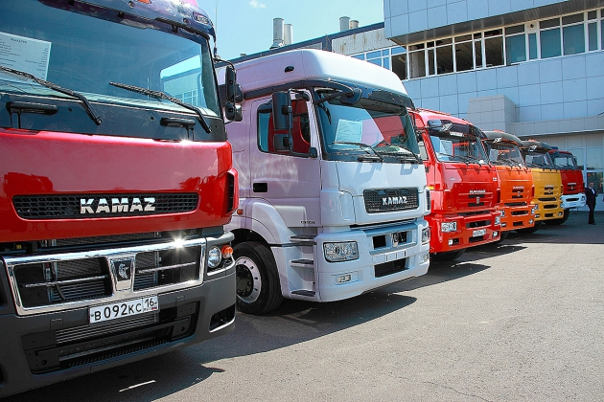
PRODUCT RANGE
Notes:
9

Slide 10
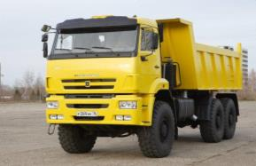
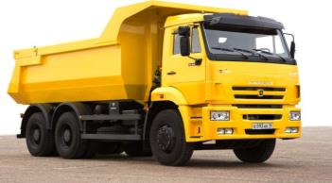
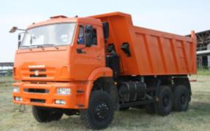
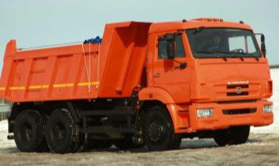
TIPPERS
KAMAZ-65222
KAMAZ-6520
High capacity – 19 t;
Good cross-country ability due to all-wheel drive (6x6), high clearance and single wheels;
High net horsepower – 400 h.p.
High capacity – 20 t;
Different volumes of tipping body – 12 m3, 16 m3, 20 m3;
High net horsepower, 400 h.p. max
KAMAZ-6522
KAMAZ-65115
High capacity – 19 т;
Good cross-country ability due to all-wheel drive (6x6) and high clearance;
High net horsepower – 400 h.p.
Capacity – 15 т;
Engine horsepower - 300 h.p.
11
9
Notes:
10

Slide 11
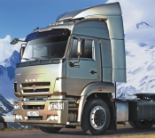
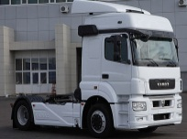
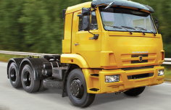
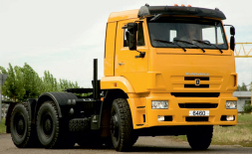
TRACTOR TRUCKS
KAMAZ-5460
KAMAZ-5490 (М1842)
Fifth wheel load – 11,5 t;
Gross combination weight – 40 t;
High net horsepower – 400 h.p.
Fifth wheel load – 11,5 t;
Gross combination weight - 44 t;
High net horsepower – 428 h.pс.
KAMAZ-65116
KAMAZ-6460
Fifth wheel load – 15,5 t;
Gross combination weight - 37,85 t;
High net horsepower – 300 h.p.
Fifth wheel load – 16,5 t;
Gross combination weight - 62 t;
High net horsepower – 400 h.p.
10
11

Slide 12
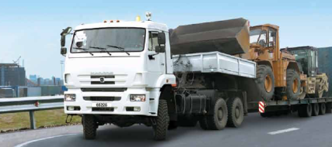
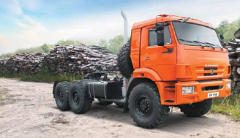
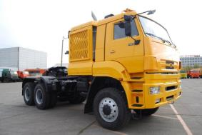
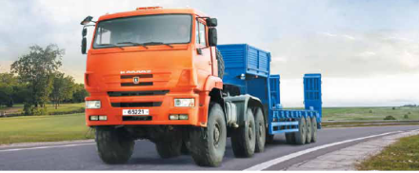
SPECIAL PURPOSE TRACTOR TRUCKS
KAMAZ-65225 (6x6)
KAMAZ-44108 (6x6)
Permissible fifth wheel load – 22 t;
Permissible gross weight of trailer with load – 63 t;
Good cross-country ability due to all-wheel drive (6x6), high clearance
High net horsepower – 400 h.p.
Permissible fifth wheel load – 10 t;
Permissible gross weight of semi-trailer with load – 22 t;
Good cross-country ability due to all-wheel drive (6x6), high clearance and single wheels;
High net horsepower – 400 h.p.
KAMAZ-65226 (6x6)
KAMAZ-65221 (6x6)
Permissible fifth wheel load – 21 t;
Permissible gross weight of trailer with load – 63 t;
Good cross-country ability due to all-wheel drive (6x6), high clearance;
High net horsepower – 535 h.p.
Permissible fifth wheel load – 17 t;
Permissible gross weight of trailer with load – 53 t;
Good cross-country ability due to all-wheel drive (6x6), high clearance and single wheels;
High net horsepower – 400 h.p.
11
Notes:
12

Slide 13
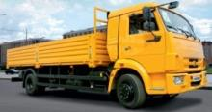
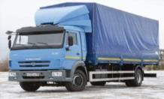
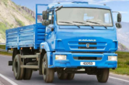
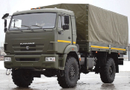
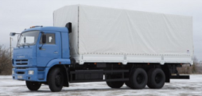
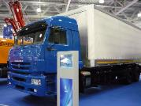
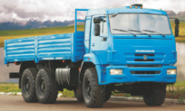
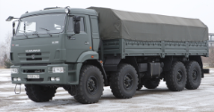
Dropside trucks
KAMAZ-4308
KAMAZ-5308
KAMAZ-43253
KAMAZ-43502
4х2 chassis type
Cummins 185 h.p. engine
Gross vehicle weight - 11900 kg
Capacity - 5730 kg
4х2 chassis type
Cummins 300 h.p. engine
Gross vehicle weight 15000 kg
Capacity 8200 kg
4х2 chassis type
Cummins 185 h.p. engine
Gross vehicle weight 14590 kg
Capacity 7820 kg
4х4 chassis type
Cummins 185 h.p. engine
Gross vehicle weight 14590 kg
Capacity 7820 kg
KAMAZ-65117
KAMAZ-6360
KAMAZ-43118
KAMAZ-63501
6х4 chassis type
Cummins 300 h.p. engine
Gross vehicle weight 24000 kg
Capacity 14500 kg
6х4 chassis type
КАМАZ 400 h.p. engine
Gross vehicle weight 26500 kg
Capacity 15600 kg
6х6 chassis type
КАМАZ 300 h.p. engine
Gross vehicle weight 21600 kg
Capacity 11280 kg
8х8 chassis type
КАМАZ 360 h.p. engine
Gross vehicle weight 26300 kg
Capacity 14000 kg

Slide 14
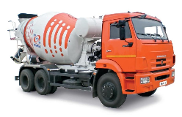
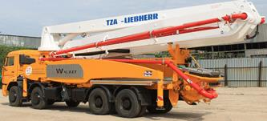
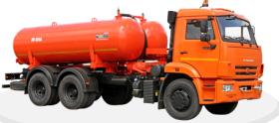
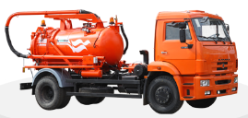
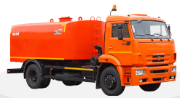
Concrete trucks
Concrete mixer trucks
Concrete pumpers
Mixer volume – from 5 to 12 cubic meters;
Wheel arrangement: 4х2, 6х4, 6х6, 8х4;
Power take-off / self-contained engine mixer drive;
Delivery head – from 21 to 47 m;
Wheel arrangement: 6х4, 8х4;
High performance - 125-160 cu m/h;
Municipal vehicles
Sewer flushers
Vacuum trucks
Sewage suction trucks
Vacuum trucks are designed for vacuum intake, transport and discharge of liquid waste containing no explosives and flammable substances.
Wheel arrangement: 4х2, 6х4, 6х6
Sewage suction trucks are designed for vacuum cleaning of wells, storm-water drainage and sewerage networks from silty mud and its transporting to the discharching place.
Wheel arrangement: 4х2, 6х4, 6х6
Sewer flushers are designed for cleaning of storm-water drainage piping from silt and blockage.
Wheel arrangement: 4х2, 6х4.

Slide 15
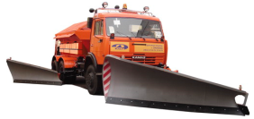
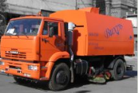
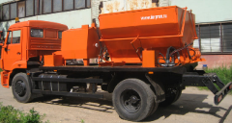
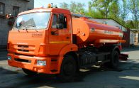
Road maintenance vehicles
Multipurpose road maintenance vehicles
Sweeping trucks
Vacuum sweeper is designed for mechanized cleaning of township roads, squares, airports with asphalt or cement concrete road surfaces from dust, sand, gravel, leaves.
Wheel arrangement: 4х2
Road maintenance vehicle is designed for snow removal from roads, spreading of liquid deicing agents in winter time and road surface cleaning and water distributing in summer time.
Wheel arrangement: 4х2, 6х4, 6х6
Road repair vehicles
Vehicles for road reconditioning
Bitumen spreaders
Vehicle for road reconditioning is designed for mechanization of repair and maintenance of roads with asphalt and bituminous mixture surfaces (patching, local surface treatment, surface creaks pouring).
Wheel arrangement: 4х2, 6х4
Bitumen spreader is designed for transportation of hot (up to +200°С) and cold liquid bituminous materials from production or storage site and their uniform distribution during construction and repair of landing fields and roads.
Wheel arrangement: 4х2, 6х4

Slide 16
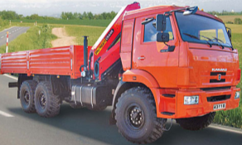
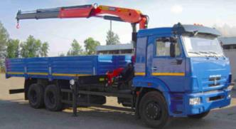
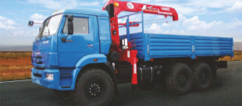
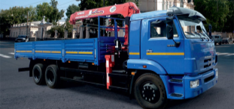
SPECIAL PURPOSE VEHICLES WITH KAMAZ CHASSIS
Scaffold trucks
High sided truck with articulated hook crane KAMAZ-43118 (6x6)
High sided truck with articulated hook crane KAMAZ-65117 (6x4)
Rear body carrying capacity – 10 t;
Crane working load limit - 3400 kg;
Мax boom-out - 8,1 m;
Good cross-country ability due to all-wheel drive (6x6), high clearance
High net horsepower – 300 h.p.
Rear body carrying capacity – 12,2 t;
Crane working load limit - 3140 kg;
Мax boom-out - 8,1 m;
High net horsepower – 300 h.p.
High sided truck with telescopic rope crane KAMAZ-43118 (6x6)
High sided truck with telescopic rope crane KAMAZ-65117 (6x4)
Rear body carrying capacity – 9 t;
Crane working load limit - 4050 kg;
Мax boom-out - 8,1 m;
Good cross-country ability due to all-wheel drive (6x6), high clearance;
High net horsepower – 300 h.p.
Rear body carrying capacity – 12,6 t;
Rear body length - 6,7 m;
Crane working load limit – 4050 kg;
Мax boom-out - 10,84 m;
High net horsepower – 300 h.p.

Slide 17
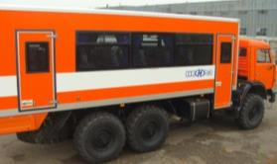
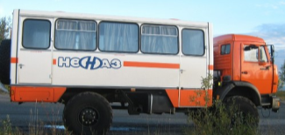
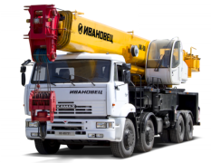
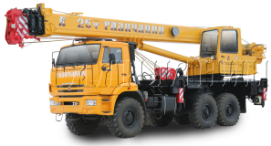
Crew buses
NEFAZ - 4208 crew bus with КАМАZ-5350 (6x6) chassis
NEFAZ - 42111 crew bus with КАМАZ-4326 (4x4) chassis
Passenger capacity - 30 people;
Good cross-country ability due to all-wheel drive, high clearance and single wheels;
High net horsepower – 280 h.p.
Passenger capacity - 22 people;
Good cross-country ability due to all-wheel drive, high clearance and single wheels;
High net horsepower – 240 h.p.
Automobile crane
Road automobile cranes
Off-road automobile cranes
Wheel arrangement: 4х2, 6х4, 8х4, 10х4
Capacity – from 16 to 70 t;
Engine horsepower – from 245 to 400 h.p.
Wheel arrangement – from 16 to 50 t;
Good cross-country ability due to all-wheel drive, high clearance and single wheels;
Engine horsepower – 300 h.p.
Notes:
17

Slide 18
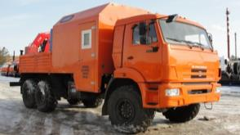
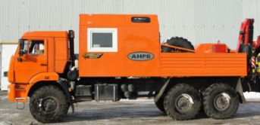
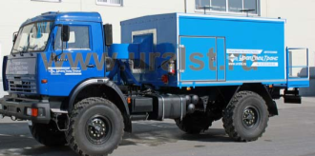
Units for Repairs and Service of the Surface Oil Equipment
Repair and Service Unit for Pumping Units with Knuckle Boom Crane on КАМАZ-43118 (6x6) Chassis
Designed to repair and provide preventive service for the equipment of the oil wells, pumping units as well as for surface equipment in the oil fields;
Package of equipment: gas cutting equipment, welding equipment, painting equipment, grease filling equipment, oil dispensing system, knuckle boom crane, removable cradle to lift personnel to a height of up to 12 meters, various tools.
Unit for Surface Repairs of Waterways with Knuckle Boom Crane on КАМАZ-43118 (6x6) Chassis
Designed for repairs and preventive service of the process equipment of the waterways, sewerage in the communal infrastructure, surface equipment of the oil fields, process pipelines at oil gathering points, elements of X-mas tree equipment and pumping units.
Package of equipment: gas cutting equipment, welding equipment, painting equipment, pump-off equipment, machining equipment, knuckle boom crane, various tools.
Universal Mobile Air Heater УМП-400 on КАМАZ-4326 (4x4) Chassis
Designed for heating up various process equipment, pipelines, engines and ventilation for production premises as well as for warming up aircraft engines and aircraft passenger compartments;
Features a heat generator, capacity 400 kW

Slide 19
Units for Construction, Repairs and Service of Pipelines
Pipe Truck 442630 on КАМАZ-65224 (6x6) Chassis
Mobile Pump Unit ПНУ-2 on КАМАZ-43118 (6x6) Chassis
Designed for:
Pumping oil out of the pipeline to empty it out for repairs;
Collecting oil and petroleum products from open oil storage pits and pumping them into the main oil pipelines;
Filling the main oil pipelines up with water from open water reservoirs when hydraulic tests are prepared (re-testing) for main oil pipelines;
Operating as a temporary oil pumping station for the main oil pipeline.
Length of Pipes Transported up to 36 m;
High load carrying capacity – 36 tons;
High engine horsepower rating – 400 HP
Units for Current Repairs of Oil Wells
Unit for Paraffin Removal of Oil Wells АДПМ-12/150 on КАМАZ-43118 (6x6) Chassis
Unit for Acid Treatment of Wells on КАМАZ-43118 (6x6) Chassis
Designed for heating up and pumping hot oil into the wells in order to remove paraffin, hot water supply for technical purposes.
Designed to transport inhibited hydrochloric acid and to pump liquid media into wells when treating the well bottom zone with hydrochloric acid

Slide 20
Units for Current Repairs of Oil Wells
Cementing Unit УНБ-160х40 on КАМАZ-43118 (6x6) Chassis
Logging Truck Hoist ПКС-5-03 on КАМАZ-43118 (6x6) Chassis
Designed for lowering and lifting operations during well logging on the wells down to 5000 m deep.
Winch with hydraulic and mechanical drive which meets stringent reliability, simplicity of control and service requirements.
Designed for pumping liquid media when cementing, washing and pressurizing operations are carried out during the process of drilling, well completion and well workover.
Fuelling Trucks, Fuel Carrier Trucks
УСТ – 54535К on КАМАZ-65224 (6x6) Truck
АТЗ-66062-213 on КАМАZ-43118 (6x6) Truck
Permissible volume of fuel carried 18 m3;
Equipped with oil filling equipment, capacity 200 liters;
High cross country capacity thanks to all wheel drive (6x6), high clearance and single tire wheels;
High horsepower rating – 400 HP
Allowable volume of fuel carried 11 m3;
Capable of being used together with tanker trailer, holding capacity of up to 10 m3;
High cross country capacity thanks to all wheel drive (6x6), high clearance and single tire wheels;
Engine horsepower rating – 300 HP

Slide 21
Fire Fighting Crew Trucks
Ladder Trucks
Knuckle Type Auto Hydraulic Lifts
Designed to deliver to the site where rescue and fire fighting operations are to be carried out a crew of fire fighters, required fire fighting gear and equipment
Wheel formula 4х2, 4х4, 6х4, 6х6, 8х4
Lift height between 30 and 60 m.
Designed to deliver to the site where rescue and fire fighting operations are to be carried out a crew of fire fighters, required fire fighting gear and equipment
Wheel formula 8х4;
Lift height 50 m.
Tanker Truck
Airport Fire Trucks
Fire fighting tanker truck is designed to deliver to the fire breakout site a crew of fire-fighters, fire fighting gear, water supply and foam agent.
Wheel formula 4х2, 6х4, 6х6;
Airport fire fighting truck is designed to extinguish fires and engage in rescue operations on aircraft and airport surface facilities.
Wheel formula 6х6, 8х8;

Slide 22
Trucks for Fire Fighting Crews
Foam Extinguishing Trucks
Powder Extinguishing Trucks
Used as an independent combat unit or as a pump unit when operated to pump from one or several tanker trucks when dousing fire with water, air and mechanical foam in residential locations and industrial facilities.
Wheel formula 4х2, 4х4, 6х4, 6х6
Powder extinguishing fire truck is designed to deliver to the fire breakout site a crew of fire fighters, fire fighting gear, a supply of fire extinguishing powder. Operated as an independent combat unit when fighting fires in petrochemical, gas, oil refining industrial facilities and electric power sub-stations.
Fire Fighting Pump Station
Pump and Hose Truck
Fire fighting pump station is designed to deliver to the site where the fire breaks out a crew of fire fighters, fire fighting gear, water supply and air mechanical foam from closed or open source through the main lines to feed pump trucks, tanker trucks and mobile fire fighting water and air foam cannons in places where is no running water supply.
Designed to deliver to the blaze site a crew of fire fighters, fire fighting gear and a supply of high pressure hoses. Used for mechanized routing and removal of main hose lines, putting fire out with water, air and mechanical foam in residential locations and industrial facilities.

Slide 23
Log Trucks, Timber Trucks
Log Truck with Knuckle Boom Crane on КАМАZ-43118 (6x6) Chassis
Timber Truck with Knuckle Boom Crane on КАМАZ-43118 (6x6) Chassis
Capable of handling log sizes up to 6.5 m long;
High cross country capacity thanks to all wheel drive (6x6), high clearance and single tire wheels;
Engine horsepower rating up to 300 HP
Designed to handle tree trunks and log sizes from 6 up to 18 m long;
High cross country capacity thanks to all wheel drive (6x6), high clearance and single tire wheels;
Engine horsepower rating up to 300 HP.
Hydraulic Lift Trucks
АГП ISOLI ЗЕО 35.22 SL on КАМАZ-43118 (6x6) Chassis
АГП ВС-22.06 on КАМАZ-43502 (4x4) Chassis
High load carrying capacity of the cradle – 300 kg;
Lift height up to 34.5 m;
High cross country capacity thanks to all wheel drive, single tire wheels and high clearance;
High engine horsepower rating – 300 HP
Load carrying capacity of the cradle – 250 kg;
Lift height up to 22 m;
High cross country capacity thanks to all wheel drive, single tire wheels and high clearance;
Engine horsepower rating – 240 HP

Slide 24
Drilling and Crane Trucks
БКМ BUER LS 1035-005 on КАМАZ – 4326 (4x4) Chassis
Rear body load carrying capacity – 3 tons
High cross country capacity thanks to all wheel drive, single tire wheels and high clearance;
High engine horsepower – 240 HP
Drilling depth down to 7 m;
Equipped with quick removal cradle, load carrying capacity of 200 kg and lift height of up to 18 m;
Load carrying capacity of knuckle boom crane up to 6100 kg;
БКМ BUER LS 2656-002 on КАМАZ – 43118 (6x6) Chassis
Load carrying capacity of rear body - 8 tons
High cross country capacity thanks to all wheel drive, 6x6;
High engine horsepower rating – up to 300 HP
Drilling depth down to 12 m;
Equipped with quick removal cradle, load carrying capacity of 200 kg and lift height of up to 23.3 m;
Load carrying capacity of knuckle boom crane up to 7500 kg;
БКМ BUER LS 2656-006 Based on Semi-Trailer Tractor Truck КАМАZ – 44108 (6x6)
Gross combination weight – 32 tons;
High cross country capacity thanks to all wheel drive, 6x6;
High engine horsepower capacity – up to 300 HP
Drilling depth down to 12 m;
Equipped with quick removal cradle, load carrying capacity of 200 kg and lift height of up to 23.3 m;
Load carrying capacity of the knuckle boom crane – up to 7500 kg;

Slide 25
Drilling and Crane Units
БКМ-512 on КАМАZ – 4326 (4x4) Chassis
Load carrying capacity – 3 tons
High cross country capacity thanks to all wheel drive, single tire wheels and high clearance;
High engine horsepower rating – 240 HP
Drilling depth down to 6 m;
Equipped with quick removal cradle, load carrying capacity of 200 kg and lift height of up to 12 m;
Load carrying capacity of the knuckle boom crane - up to 4000 kg;
БКМ-KDC5600 on КАМАZ – 43118 (6x6) Chassis
High cross country capacity thanks to all wheel drive, 6x6;
High engine horsepower rating – up to 300 HP
Drilling depth – 4.5 m;
Capable of mounting a cradle, load carrying capacity of 200 kg and lift height of up to 12.8 m;
Load carrying capacity of the knuckle boom crane up to 4000 kg;
Laboratories, Self-Propelled Garages (Workshops)
Vehicle Repair Unit АРК-2 with Knuckle Boom Crane on КАМАZ-43114 (6x6) Chassis
Designed for companies who are in the business of servicing electrical, radio broadcasting, telephone and telegraph as well as relay networks;
Equipped with:
Hydraulic handler to carry out loading and unloading operations, installation work;
Hydraulic bore (bore diameter is 360 mm);
Stand-Alone Diesel Unit АДД-2003У2 for Welding;
Quick removal two seater cradle for work to be done at a height of 12 m.

Slide 26
Laboratories, Self-Propelled Workshops
Self-Propelled Welding Facility ПКСР-M on КАМАZ-43118 (6x6) Chassis
High Voltage Test Laboratory on КАМАZ-43114 (6x6) Chassis
Incorporates equipment to do the welding, gas cutting, installation, repair and construction work;
Engine power rating – 300 HP
Used to test switchgears as well as power cable lines with voltage from 10 kV to 35 kV and more;
Engine power rating – 240 HP
High Voltage Line Personnel Truck АСВЛ-5 on КАМАZ-4326 (4x4) Chassis
Mobile Vehicle Repair Workshop ПАРМ on КАМАZ-43114 (6x6) Chassis
Multi-role truck incorporating equipment to perform current repairs and technical maintenance of trucks, special purpose wheeled cab and chassis units and tracked vehicles in the field;
Comprises a synchronous generator, drilling machine, combination turner and grinder, a vice, metal workbench, gas cutting equipment, welding equipment, washing, knuckle boom crane, etc.
Used for transportation of crews and necessary equipment to job site;
Engine power rating – 240 HP

Slide 27
Features of Truck Builds
Polar Configuration
Depending on the truck build, trucks can be fitted out with polar options which include:
Cab heat insulation;
Coarse and fine fuel filter warm-up;
Fuel feed system warm-up;
Storage battery heat insulation;
Self-contained cab heater;
Driver and passenger seat heat-up;
Mirrors with electric heaters;
Use of special oils and fluids
Tropicalized Configuration
Depending on the truck build, trucks can be fitted out with tropicalized options which include:
Air conditioner installation;
Additional anti-corrosive proofing;
There is no heater or pre-start heater (glow-plug);
Use of special oils and fluids.
For Right Hand Drive Countries
For right hand drive countries there are options of volume produced trucks with right hand drive.

Slide 28
UNIQUE SELLING PROPOSITION FOR KAMAZ COMPRESSED GAS VEHICLES
Approximate cost ratio of vehicles using different fuel
Additional profit on fuel for gas dump truck exceeds 7,4 mln. RUR for 10 years
Diesel LHCG CNG
1. Efficiency. Compressed gas costs less than diesel fuel (1 m3 of CG corresponds to appr. 1 l of diesel fuel, almost 3 times saving on fuel).
2. Exceeds Euro-4 (no need for high-priced catalyst systems and urea, this provides additional saving on operating costs);
3. Low noise. This is most vital for city conditions (buses, municipal vehicles).
4. Safety. CNG is more secure than liquefied blau gas and gasoline.
5.Service. The customer of compressed gas vehicles needs full guarantee of complete maintenance on the territory of Russia including spare parts.

Slide 29
KAMATEINER – LOGISTICS OF THE WINNERS
Express delivery is shipping of goods on draw arm 250-300 km. with demountable bodies
Comparison of delivery costs by different kinds of transport
The vehicle runs 24 hours a day on a short arm, and has back loading
The risk of failures, vehicle and freight downtimes is low.
Sea transport
Railway
Truck transport
KAMATEINER (Diesel)
KAMATEINER (compressed methane)
KAMATEINER (liquefied methane)
2 times reduction of shipment expenses
3 times and more of inventory turnover acceleration
3-5 times reduction of transport demand
3 times reduction of freight delivery time
System of express delivery including trailer trucks and demountable bodies, containers is more efficient:
2,3 times against standard transport;
1,7 times against rail transport.
Deadlines of freight express delivery and financing of working capital are less than:
5 times against rail transport;
7-8 times – against sea transport.
To reduce the road load
To reduce accident rate
To improve environment
Commercial speed of product promotion will exceed 1400km/day

Slide 30
POWER PLANT UNITS
АД100С-Т400-1Р Power plant unit
АП100С-Т400-1Р Gas piston power generating unit
KAMAZ offers a range of diesel power generating units of 100, 150, 200 kW. and gas piston power generating units of 100 kW including home-produced and foreign generators.
Advantages of АД100 over power plant units with home-produced diesel engines:
- less fuel consumption;
- more ecofriendly engine (diesel – Euro –1-3, gas piston - Euro–3);
- engines of less dimensions and weight.
This base component unit is designed for crane travelling.
The unit of base components with machanical fuel injection pump drive provides precision class 3 according to GOST 10511 – 83, electronically controled fuel injection pump provides 2 precision class.
Notes:
30

Slide 31
MODEL RANGE OF NEFAZ BIG PASSENGER BUSES
City bus
Suburban bus
Gas
Intercity bus
Diesel
Gas
Diesel
Diesel

Slide 32
5299 NEFAZ DIESEL SUBURBAN PASSENGER BUSES
Total passenger capacity / Places for seats | 96,89/45
Bus curb weight, kg | 10980
Bus gross weight, kg | 17900
Overall dimensions | 11885*2500*3144…3250
Step height over the road level, mm | 360
Floor height in the front part, mm | 730
Aisle width between the doors, mm | 1200
Max. speed, km/h | 90
Wheel arrangement / driving wheels | 4х2 / rear
Engine | Cummins ISB6.7e4270B (EURO-4)
Max. net capacity, kW (h. p.) | 188 (270)
Max. net torque, Nm (kg·cm) | 940
Displacement, l. | 6700
Gear box | ZF 6S 1200BO / ZF 6HP 504C or VOITH D 854.3Е
Type | Mechanical / Automatic
Brakes | WABCO drum, rear and front
Final drive | RABA, dual
Front suspension | Rigid axle type, pneumatic
Rear suspension | Rigid axle type, pneumatic

Slide 33
5299 NEFAZ CNG SUBURBAN PASSENGER BUSES
Total passenger capacity / Places for seats | 89/45
Bus curb weight, kg | 11800
Bus gross weight, kg | 17900
Overall dimensions | 11885*2500*3495
Step height over the road level, mm | 360
Floor height in the front part, mm | 730
Aisle width between the doors, mm | 1200
Max. speed, km/h | 90
Wheel arrangement / driving wheels | 4х2 / rear
Engine | KAMAZ -820.61-260 (EURO-4)
Max. net capacity, kW (h. p.) | 191 (260)
Max. net torque, Nm (kg·cm) | 931
Displacement, l. | 11762
Gear box | ZF 6S 1200BO
Type | Mechanical
Brakes | WABCO drum, rear and front
Final drive | RABA, single, hypoid
Front suspension | Rigid axle type, pneumatic
Rear suspension | Rigid axle type, pneumatic

Slide 34
INTERCITY PASSENGER TRAVEL 5299 ON DIESEL
 | 5299-37-42 |  | 5299-17-42
Total passenger capacity / Places for seats | 71,69 / 42,44,46 |  | 73,71,69 / 42,44,46
Bus curb weight, kg | 12360 |  | 11600
Bus gross weight, kg | 17900 |  | 17900
Overall dimensions | 12000*2500*3174…3280 |  | 11885*2500*3174…3280
Step height over the road level, mm | 360
Floor height in the front part, mm | 730
Aisle width between the doors, mm | 700
Max. speed, km/h | 90 | 70
Wheel arrangement / driving wheels | 4х2 / rear
Engine | Cummins ISB6.7e4270B (EURO-4)
Max. net capacity, kW (h. p.) | 188 (270)
Max. net torque, Nm (kg·cm) | 940
Displacement, l. | 6700
Gear box | ZF 6S 1200BO, ZF 6HP 504C or VOITH D 854.3Е
Type | Mechanical / Automatic
Final drive | RABA, dual
Front suspension | Rigid axle type, pneumatic / Independent, pneumatic | Rigid axle type, pneumatic
Rear suspension | Rigid axle type, pneumatic | Rigid axle type, pneumatic
Luggage compartment volume, m3 | 5 | 3

Slide 35
ADDITIONAL OPTIONS INSTALLED ON BUSES NEFAZ-5299
№ | Description
1 | Original paint Оригинальная покраска автобуса
2 | GPS / GLONASS navigation system installation
3 | Northerly options installation
4 | Electronic route guide
5 | Voice information device
6 | Ticker inside the vehicle
7 | Air conditioner
8 | Video system
9 | Enhanced comfort seats
10 | Changes to interior configuration at customer’s option
11 | Solid partition for the driver in suburban service bus
12 | Automated centralized lubrication system of "Lincoln"
13 | Video recorder
14 | Video surveillance inside the bus
15 | Nave plates

Slide 36
FUTURE MODELS
Medium sized city bus with compressed natural gas / diesel (total capacity 72 pax /seating capacity 24pax)
Medium sized coach with compressed natural gas / diesel (total capacity 42 pax /seating capacity 34 pax)

Slide 37
NEFAZ-52992
Self supporting electrically driven motion for over 200 km.
Lithium iron phosphate battery with energy storage capacity of 313,6 kWh is located on the roof, inside the vehicle and in the rear overhang of the bus.
Electric bus is equipped with 48 kW charger, complete recharging of the electric bus takes 8 hours.
In order to have quick recharge (20-30 minutes) from 500 kWh source, the electric bus NEFAZ-52992 is equipped with special power connectors.
Electric bus NEFAZ-52992 is equipped with telemetering system, which conveys information by means of GLONASS or GSM to remote computer to control over status parameters of the battery and major units.

Slide 38
HIGH TECHNOLOGICAL POTENTIAL
Transition from special equipment to widely functional equipment to perform turning, milling, drilling, grinding operations on a single production unit (machining centers and machines with CNC)
_{flexibility}
High-speed and highly-accurate machining with a cutting tool based on artificial superhard materials with no use of cutting fluids
_{productivity}
Manufacturing technological cells, providing the maximal return on assets, concentration of the same type of process stages
_{compactness}
energy and resource efficiency
Energy-saving technologies, work materials with minimal allowances, modern materials (high depth of hardening steel, low-cost-alloy and low-carbon steel with increased formability, strength, durability)
_{IT}
Computer aided design systems to design production stage modeling involving process simulators and production simulators
Notes:
38

Slide 39
QUALITY AWARDS
2004 | Competition for the award of the Government of the Russian Federation in the field of quality, awarding the title “The Award Winner of the Competition For the Prize of the Government of the Russian Federation in the field of quality in 2004“
2005 | Competition for the award of the Government of the Russian Federation in the field of quality, Laureate of The Award of the Government of the Russian Federation in the field of quality
2007 | Russian Quality Assembly (The award founder – Centre for Marketing and Management (CMM), Switzerland), “Golden Quality Certificate” winner
2011 | European fund of quality management (EFQM) Certificate. The document officially confirms the achievement by KAMAZ of the highest grade of “Recognized for excellence – 5 stars” and also puts the company on the register of successful companies of Europe.
2013 | European Fund of Quality Management (EFQM) Certificate. The document officially verifies the achievement of the highest grade of “Recognized for excellence – 5 stars” by KAMAZ
2013 | 9th International Quality Tournament of Central and Eastern European Countries, the winner of the International Quality Tournament of Central and Eastern European countries
Notes:
39

Slide 40
AWARDS FOR QUALITY

Slide 41
THANK YOU!
PTC KAMAZ
2, Avtozavodskiy Av., Naberazhnye Chelny,
Republic of Tatarstan, 423827, Russia, т. +7-800-555-00-99 www.kamaz.ru
Notes:
41

